Slide 1
Credit Card Approval Predictions
Jose Eduardo Cadena A01704641

Slide 2
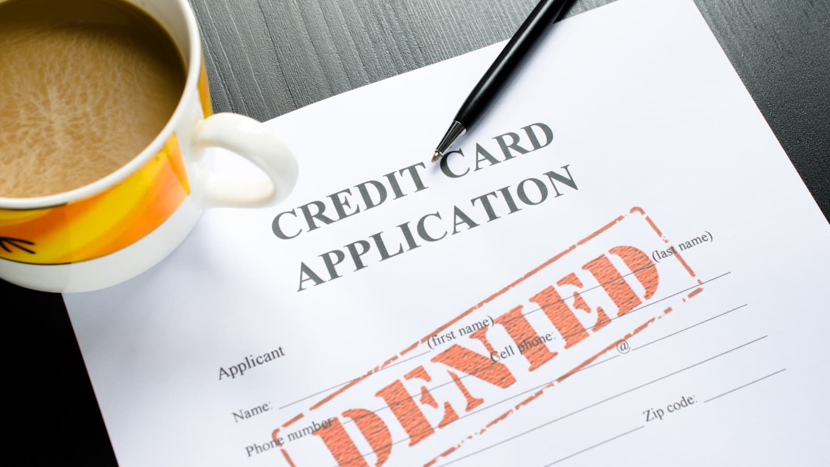

Commercial banks receive a lot of applications for credit cards. Many of them get rejected for many reasons, like high loan balances, low income levels
Manually analyzing these applications takes a lot of time, and time is money

Slide 3
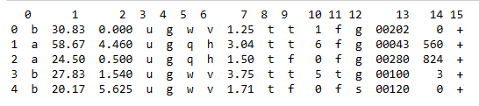
Dataset!

Slide 4
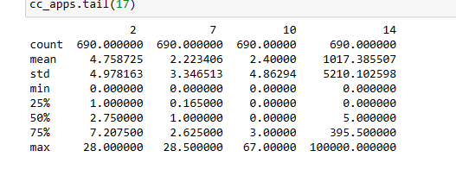
The features of this dataset have been anonymized to protect the privacy
Gender, Age, Debt, Married, BankCustomer, EducationLevel, Ethnicity, YearsEmployed, PriorDefault, Employed, CreditScore, DriversLicense, Citizen, ZipCode, Income and finally the ApprovalStatus.

Slide 5
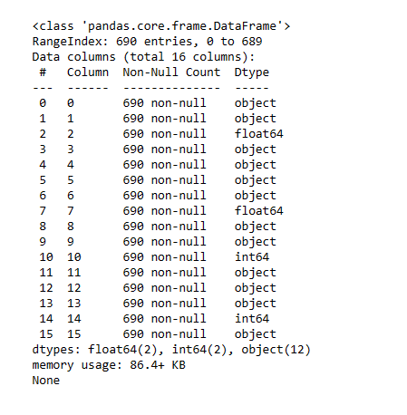

Slide 6
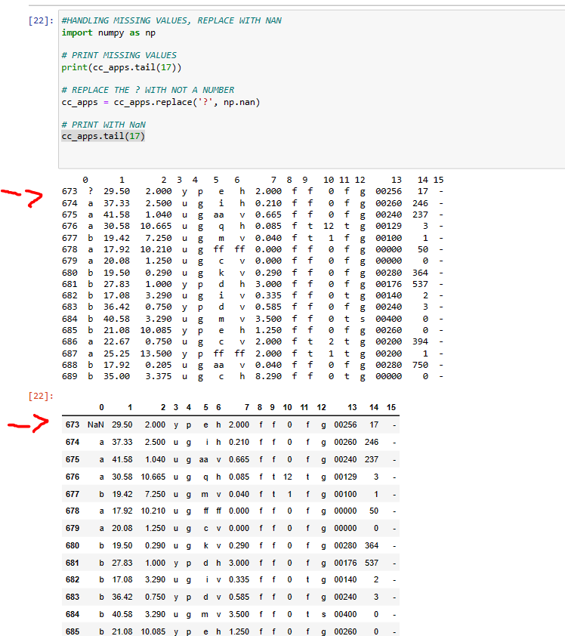

Slide 7
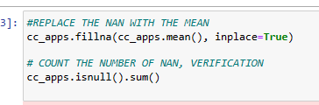
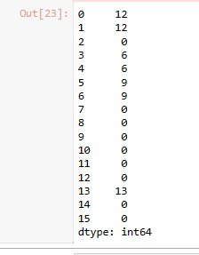

Slide 8
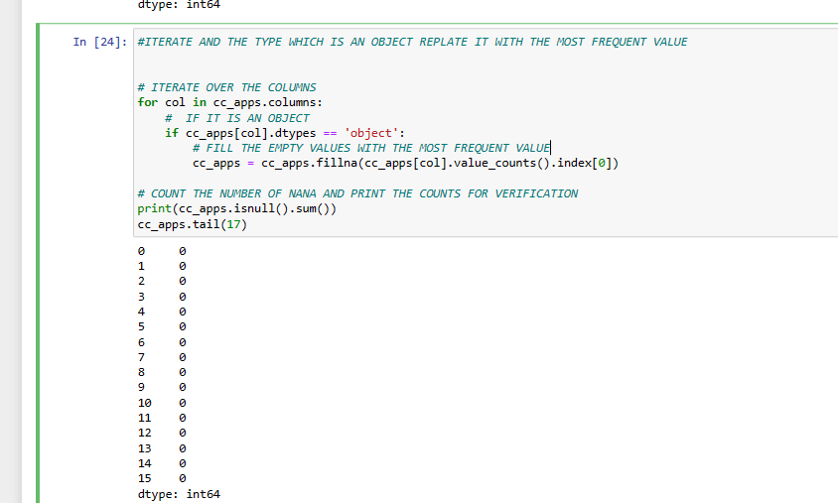

Slide 9
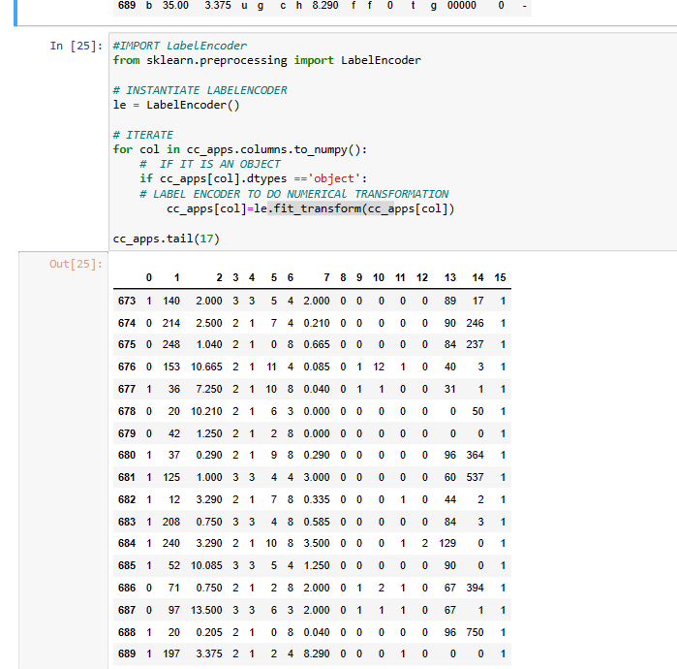

Slide 10
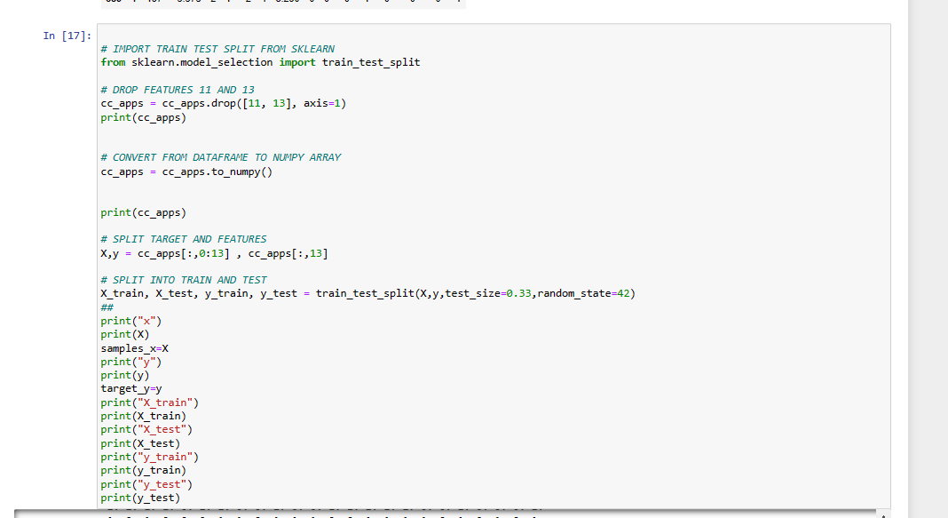

Slide 11
Precision, Recall and F1-score
Precision is a measure of the accuracy of the model's positive predictions, that is, of the conclusions of the model's positive predictions that are actually true positives.
El recall, también conocido como sensibilidad (sensitivity) o tasa de verdaderos positivos (true positive rate, TPR), es una medida de cuántas de las instancias positivas en los datos de prueba el modelo es capaz de identificar correctamente.

Slide 12
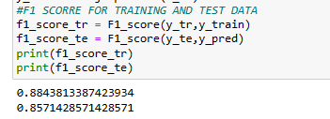

Slide 13
Thanks!

